Slide 1

Household Debt Analysis
Lydia Akalu

Slide 2
About the dataset
Dataset Overview:
Source: Household Debt Dataset
Scope: Total debt contributions broken into six categories:
Mortgage
HE Revolving (Home Equity)
Auto Loan
Credit Card
Student Loan
Other
Time Frame: Multiple quarters spanning across several years.

Slide 3
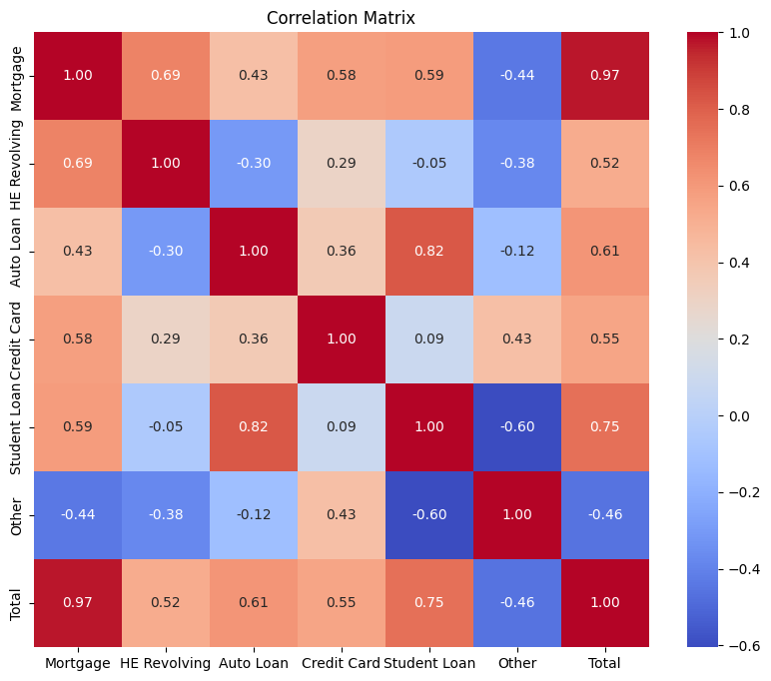
Correlation Heatmap
This heatmap shows the correlations between various debt categories.
Key observations:
Mortgage Debt has a strong positive correlation (0.97) with Total Debt, indicating its major contribution.
Auto Loan and Student Loan are moderately correlated (0.82), suggesting a trend in borrowing behaviors.
Other Debt has a weak negative correlation (-0.44) with Mortgage Debt and Total Debt, showing it behaves independently.

Slide 4
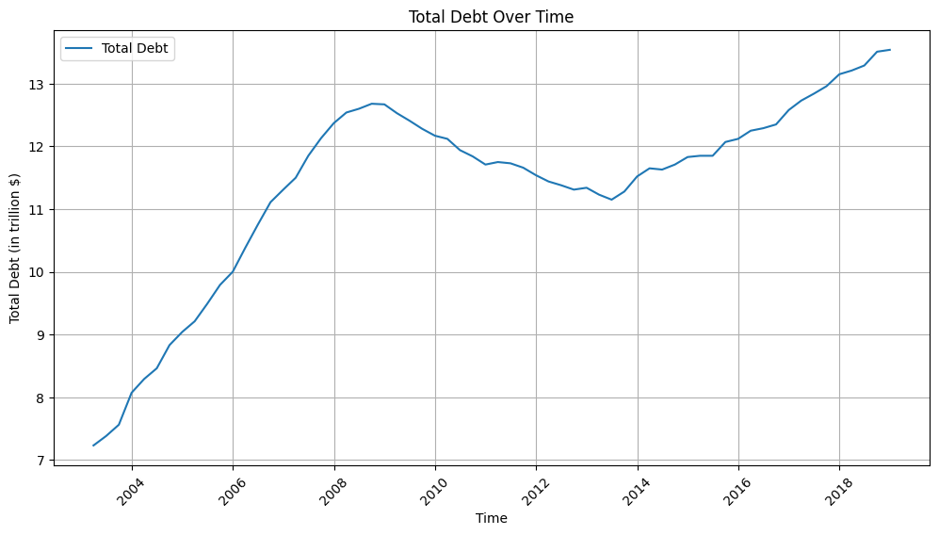
Total Debt Trend Over Time
This graph tracks Total Household Debt over time (2003–2019).
Key trends:
Debt increased sharply between 2003–2008, peaking at over 12 trillion dollars before the financial crisis.
Debt has been rising steadily since 2014.

Slide 5
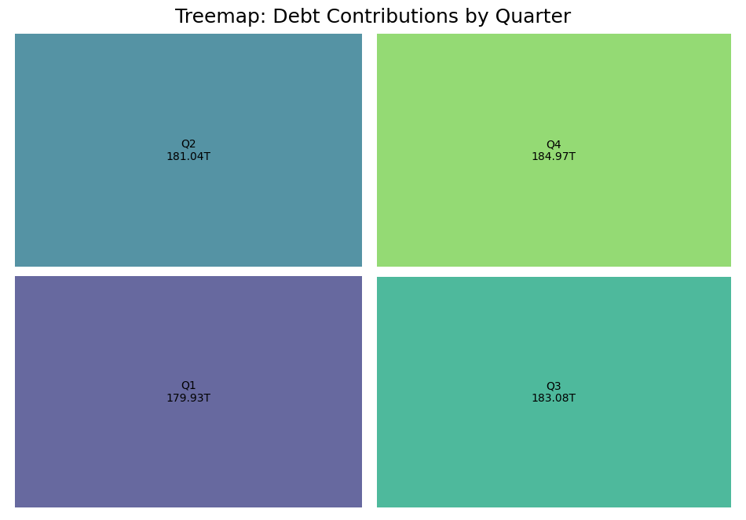
Debt Contributions by Quarter
This treemap highlights total household debt contributions across the four quarters: Q1, Q2, Q3, and Q4.
Key observations:
Q4 has the highest total debt at 184.97T, likely due to year-end spending and borrowing.
Q1 has the lowest total debt at 179.93T, reflecting repayment of Q4 obligations and reduced borrowing.
Q2 and Q3 are fairly stable at 181.04T and 183.08T, respectively.

Slide 6
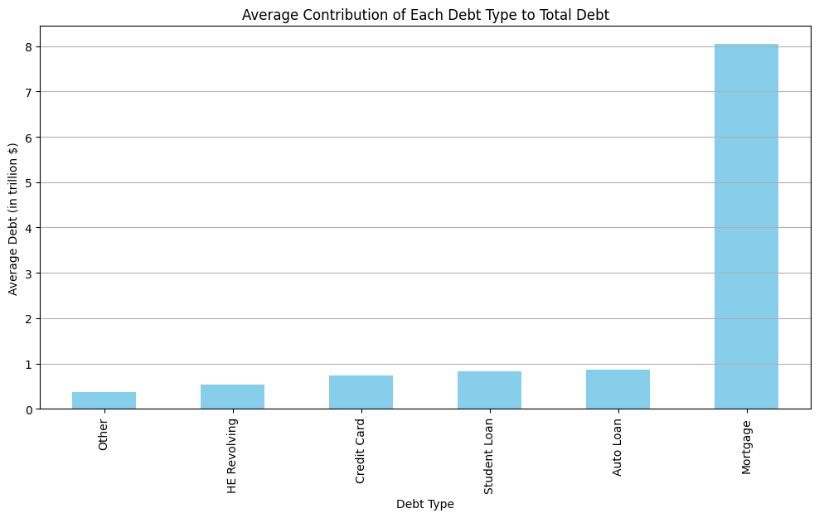
Average Contribution of Each Debt Type
This chart displays the average contribution of each debt type to total household debt.
Mortgage Debt dominates, contributing over 8 trillion dollars, far surpassing other categories.
Categories like Auto Loans, Student Loans, and Credit Card Debt contribute relatively smaller amounts, around 0.8 trillion each.
HE Revolving Debt and Other Debt have the smallest contributions.

Slide 7
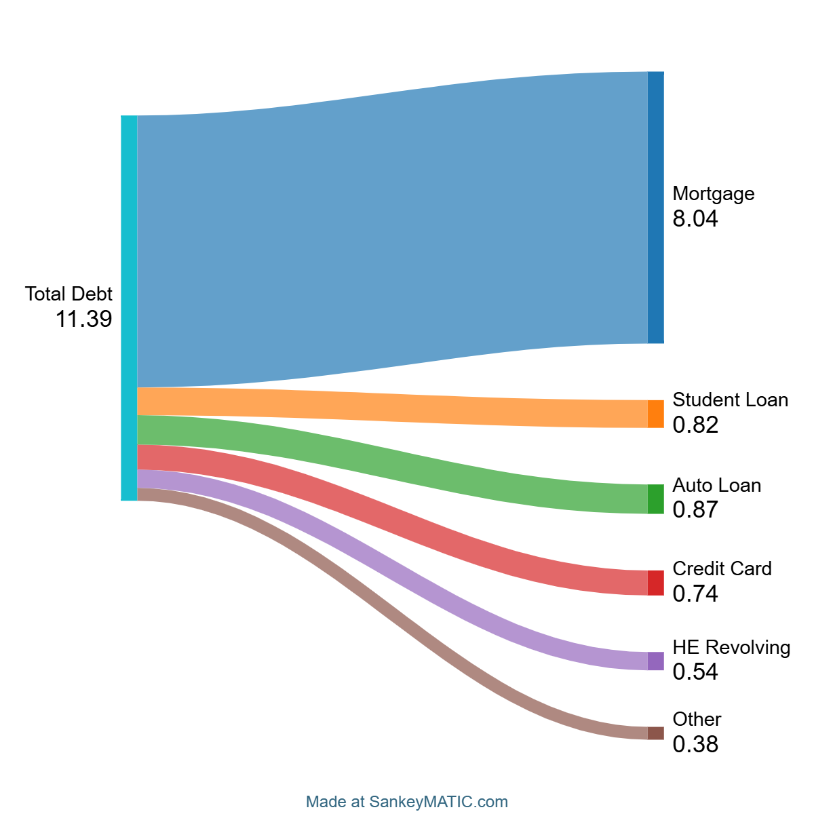

Slide 8

Thank you!

